Slide 1

The introduction of Phytiatry (Plant medicine) in Universities as a distinct science, is a primary necessity for food security and modernization of global agriculture
ELEFTHERIOS (ERIS) TJAMOS
Agricultural University of Athens, Greece

Slide 2
It is really magic for me to be here in India, one of the most historical and beautiful countries of the world.
Special thanks to the organizers for inviting me to present my proposal concerning the introduction of the Phytiatry in Universities world-wide.

Slide 3
Medicine in humans and Veterinary medicine in animals are based on extensive University education and are practiced following specializations to secure efficient and qualitative application.
However, Phytiatry (Plant Medicine),
so significant for food security, for preventing enormous income losses in world agriculture and so important for elevating the status of plant health services internationally, has not yet been introduced in Universities and recognised as a distinct curriculum.

Slide 4
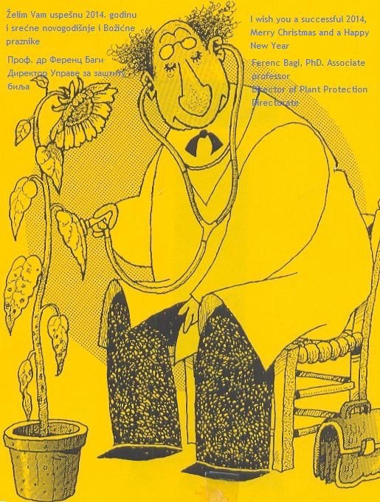
Instead, agronomists, horticulturists, biologists, microbiologists, botanists, chemists, postgraduates in plant protection, or even not University educated individuals, trained to work in plant clinics and called plant doctors deal with the application of Phytiatry globally.

Slide 5
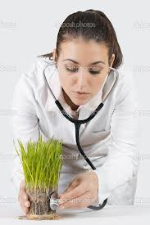
But we are all well aware that there is no scientific profession, which can be based on unrelated University studies.
Similarly real Phytiatry Doctors can not be originated from sciences not focused entirely on Phytiatry.

Slide 6
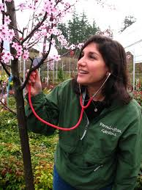
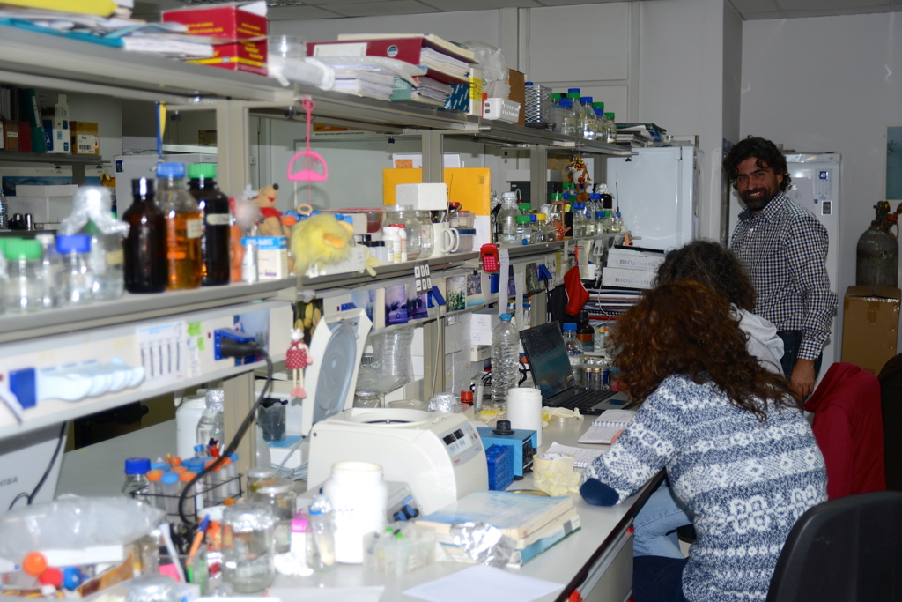
Thus, in an era of super specialization, qualified scientists with a deep and broad Phytiatry educational background, able to work as practitioners Phytiatry doctors or in plant clinics are still lacking.

Slide 7
However, several scientific societies or Universities use the terms
Phytiatry or Plant Medicine for various reasons
In Germany many famous Universities have long ago introduced the term Phytomedicine and even today provide text books to their students entitled Phytomedicine.
In Italy they used the term Fitoiatria (equivalent to Phytiatry), while University of Bari introduced the term Μedicina delle piante (Plant medicine), a term also adopted by the Universities of Florence and Bologna (M.Sc. degree in Medicina delle piante).
In France or in French speaking countries (e.g. Canada, Belgium, Morocco, Algeria and Tunisia) the term Phytiatry is occasionally used, while M.Sc. projects are offered with the name Phytiatrie and Phytopharmacie.

Slide 8
Moreover
In Belgium the University of Leuven offers currently a course entitled Principles of Phytiatry and not in Plant Protection.
In Switzerland the Swiss Society of Phytiatry uses the term Phytiatry.
In Greece the Hellenic Society of Phytiatry has proposed the introduction of Phytiatry as a separate University discipline analogous to Veterinary Medicine.
In Spain the Spanish Association of Plant Health is a newly established scientific society to promote plant health as a specialized profession.

Slide 9
In Asia we can also spot Universities using similar or identical terms
In Japan, Hosei University Department of Clinical Plant Science
In South Korea, Chungbuk National University, Department of Plant Medicine
In Taiwan
National Chiayi University, Department of Plant Medicine.
National Pingtung University of Science and Technology, Department of Plant Medicine.

Slide 10
So let’s speak about
PHYTIATRY (PHYTOMEDICINE, FITOIATRIA, PLANT MEDICINE)
by presenting arguments emphasizing the fundamental particularity of sciences included in the Phytiatry
by demonstrating the requirement for upgrading Phytiatry education on basic and applied disciplines at an undergraduate level,
and by focusing on international actions leading to a discrete University curriculum and to a distinct, and very important profession.

Slide 11
Let me underline the basic scientific concepts involved in Phytiatry
PHYTIATRY AND PHYTIATRY- DOCTORS
Plants, are affected by numerous abiotic diseases, such as nutritional deficiencies; nutrient or mineral toxicities; meteorological extremes; toxic soil and air pollutants; improper cultural practices; etc.
Plants, in addition to being attacked by fungi, bacteria, viruses, phytoplasmas and nematodes, are also attacked by many other biotic causes of injury, such as insects, mites, slugs, rodents and field mice, or other parasitic plants; while constantly compete with numerous weeds for space, water, nutrients, and light.

Slide 12
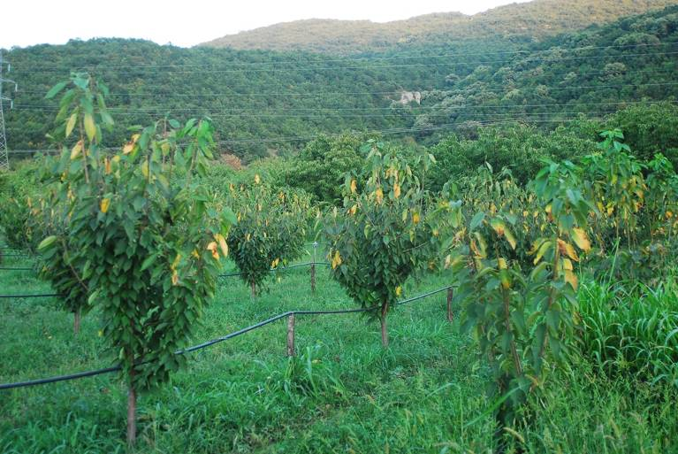
That’s why here in a Cherry orchard we need Phytiatry doctors able to diagnose symptoms caused either by Phytophthora sp., Verticillium dahliae, Armillaria mellea, or insect damage ^{by Capnodis} tenebrionis or waterlogging or... even rodent injury?

Slide 13
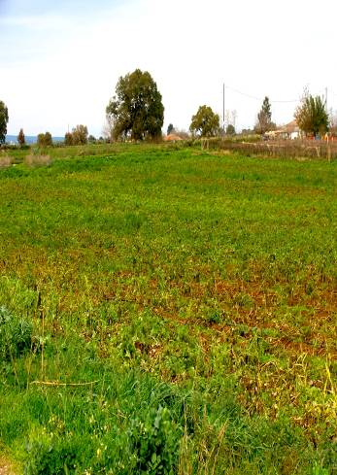
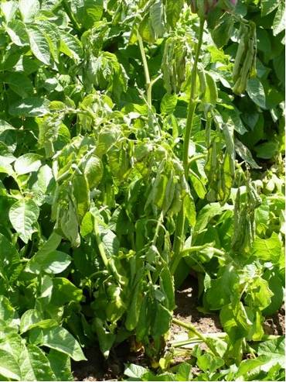
Potato field we must be able to diagnose either
Verticillium dahliae, Phytophthora infestans or Dickeya solani………?

Slide 14
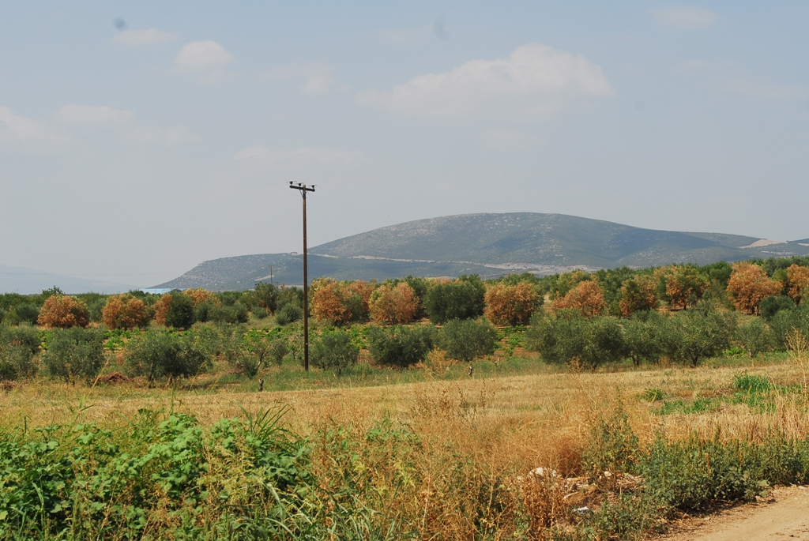
Olive orchard
we must be able to diagnose either
Verticillium dahliae, Zeuzera pyrina, Phomitiporia mediterranea or Xyllela fastidiosa, etc. ?

Slide 15
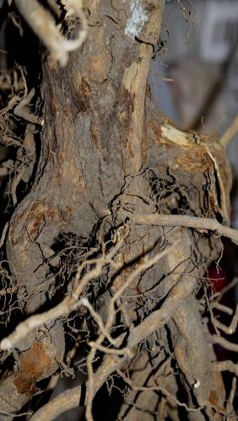
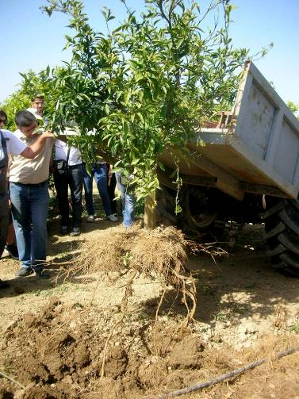
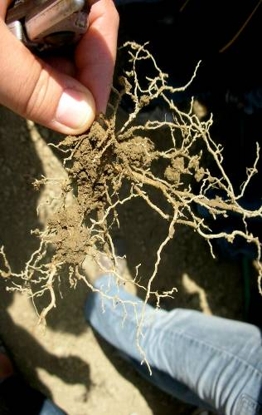
Citrus orchard
we must be able to diagnose either
Fusarium solani, Phytophthora sp., waterlogging or nematodes ?

Slide 16
But…
How many plant pathologists, entomologists or other related specialists are qualified by their training to solve problems caused by any of the factors other than those they specialized in?
Some extension specialists, once on the job, learn on their own or from colleagues how to deal with these problems, if they have to.
But so do the farmers.
That’s not the training one should expect from an “expert” on whose diagnosis and recommendation entrusts one his livelihood.

Slide 17
plants NEED their REAL Phytiatry doctors
TO REPLACE THE SO-CALLED PLANT DOCTORS
IN PLANT DISEASE AND PEST DIAGNOSIS
Just because Guessing the cause of a plant disease either from a superficial oral examination of a specimen or through a digital image does not mean professional diagnosis.
However, this is a regular practice followed by the great majority of the so-called plant doctors, who are trying to identify pest and diseases through a simple view, without even using technical or diagnostic tools …
Unfortunately scientific inadequacy of unspecialized scientists dealing with plant disease and pest diagnosis, leads to unjustifiable amateurism.

Slide 18
as we need Medicine in humans and Veterinary MEDICINE in animals
WE NEED Phytiatry IN PLANTS
Beyond any doubt modern Agriculture needs Phytiatry as a separate University curriculum to obtain the distinct and attractive profession of Phytiatry doctors…..
able to work in the labs but also in the fields, to diagnose the causes of the diseases, identify pests and weeds, and when needed play the intermediate role between farmers and plant clinics or research institutes, where plant samples could be forwarded for more specialized work.
Phytiatry doctors, το transfer to the agricultural practice the new research data through a private or state controlled extension service or through the plant clinics.

Slide 19
THE PROFESSION
OF PHYTIATRY DOCTORS AND THEIR DUTIES
Plant clinics world-wide run by Universities, Research Institutes or Private Companies can substantially contribute to the scientific diagnosis of diseases and pests, when scientists of different specializations can work together and cover the diversified needs of Applied Phytiatry.
However, these Institutions are unable to cover the vast needs for specialists in the actual sites of practicing agriculture, where tens of thousands of complicated plant specimens daily, have to be checked for pests and diseases world-wide.
So, the practitioners able to deal with various problems on the spot are really lacking, since this can only be achieved by University educated Phytiatry doctors.

Slide 20
And is this inadequacy, which
destroys millions of tonnes of plant products due to improper diagnosis and incorrect management of abiotic, biotic diseases and pests
degrades the quality and reduces expected quantity of world plant products
wastes enormous amounts of money to unneeded pharmaceuticals
restricts farmers income
pollutes the agricultural environment

Slide 21
global effort of Plantwise developed and led by CABI
I do appreciate the global effort of Plantwise developed and led by CABI to increase food security and improve rural livelihoods by reducing crop losses.
A real precious initiative for improving people’s lives by providing usuful information on plant health management.
Independently of their useful contribution to several countries around the globe, my belief is that plant doctors must be graduates of Phytiatry schools and not scientists of inadequate scientific education or questionable training.

Slide 22
POSTGRADUATE STUDIES IN PHYTIATRY
Universities of Florida and Nebraska
I believe that late Prof. George Agrios’ initiative to introduce the degree of Doctor in Plant Medicine in Florida or Prof. Vidaver of Doctor in Plant Health in Nebraska and avoid the doctor in Plant Protection was a great step for Phytiatry.
Please note however, that under their scheme the total duration of undergraduate plus postgraduate studies is a very time consuming and thus not attractive procedure.

Slide 23
Other Universities
Other Universities around the globe also adopted the programs of the University of Florida to offer Post graduate degree in Plant Medicine.
In Japan, Hosei University
In South Korea, Chungbuk National University
In Taiwan National Chiayi University and National Pingtung University of Science and Technology
Or in European Union operate their own programs
Italy master’s degree in Medicina delle piante in the Universities of Bari, Firenze and Bologna
Tempus Project in Plant Medicine among several EU and Balkan countries (Italy, Greece, Bulgaria Serbia, Croatia, FYROM, Kosovo)
University of Thessaly Greece, Phytiatry and Environment

Slide 24
But is it enough?
According to my long standing experience, M.Sc. or Ph.D. degrees in Plant Protection programs are generally inadequate to meet specific qualifications for the profession of Phytiatry doctors since these graduates are very specialized thus, unable to become practitioners Phytiatry doctors.
Moreover, the numbers of those students following doctorate programs in Plant Medicine (Universities of Florida, Nebraska or M.Sc. elsewhere) is exceptionally small to work as practitioners, so they cover very specific jobs.

Slide 25
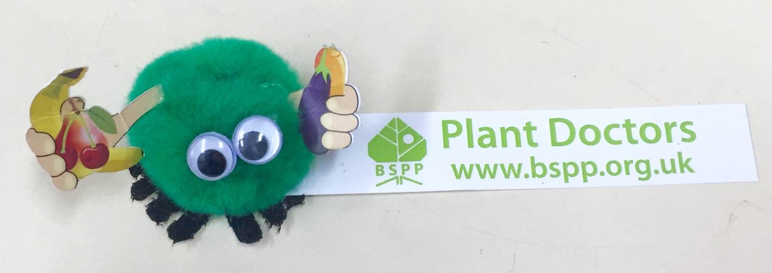
THAT’S WHY we have got the CURRENT INTERNATIONAL ALERT BY
AMERICAN PHYTOPATHOLOGICAL SOCIETY (APS)
AND BRITISH SOCIETY FOR PLANT PATHOLOGY (BSPP)
Alarming reaction by British Society for Plant Pathology stating that Britain's ability to combat new diseases is threatening due to the loss of skills and expertise in plant pathology.
American Phytopathological Society produced and loaded YouTube videos to emphasize the emerging need for plant doctors.
They rather consider as plant doctors the plant pathologists only !!!!!!!
I do stress however, that we need Phytiatry doctors ……….

Slide 26
UNDERGRADUATE STUDIES IN PHYTIATRY
What is the current situation?
Today there is an obvious scientific gap in Phytiatry sciences at an undergraduate level world-wide.
Regardless of the enormous differences in crop cultivations and agricultural systems existing around the world (e.g. Monoculture Versus Multiculture) the principles and the problems are similar everywhere.
So, the profession of Phytiatry doctors is a necessity at a universal level.

Slide 27
Over 40 different scientific courses with laboratory and field practice and training could be PROPOSED in the interdisciplinary SCIENCE of Phytiatry within a five years’ curriculum
AS STANDS FOR VETERINARY MEDICINE
SCIENTIFIC COURSES IN PHYTIATRY

Slide 28
A. Phytiatric sciences
Phytopathological Mycology, Plant Bacteriology, Plant Virology,
Molecular Plant Pathology,
Plant disease Epidemiology,
Agricultural Entomology, Agricultural Zoology,
Nematology,
Weed Science,
Phytopharmacy and Pesticide application
Plant Breeding for plant disease and pest resistance,
Biological management of plant diseases and pests
Principles of plant disease and Pest Diagnosis,
Plant Protection Strategies, Identification of new diseases, pests and weeds,
Plant Physiology and Biochemistry, Molecular Biology,
Disease and Pest Monitoring,
Biotechnology, Ecotoxicology, Environmental Protection,

Slide 29
B. AGRONOMIC SCIENCES
Basic knowledge of general and specific Pomology,
Viticulture, Horticulture, Floriculture, General and Special Agriculture,
Forestry, Farming systems.
Soil Science,
Soil management and Fertilizers, Multiplication of plant breeding,
Ecology and landscape architecture,
Communication and information,
Socio-economic impact of applied plant medicine,
Quality production, Consumer protection,
Production Systems,
Stored-Product Protection,
Harvest Processing,
etc.

Slide 30
Supporting ARGUMENTS
The existing scientific societies using the terms Phytomedicine, Medicina delle piante, Plant medicine, Phytiatry or Plant Health apparently also reflect their focusing on a necessary science and an attractive name for a distinct and recognised profession.
But also highlight the role of Phytiatry in modern agriculture.
Several strong arguments could be put forward in support of the introduction of Phytiatry in Universities as a distinct multidisciplinary science.

Slide 31
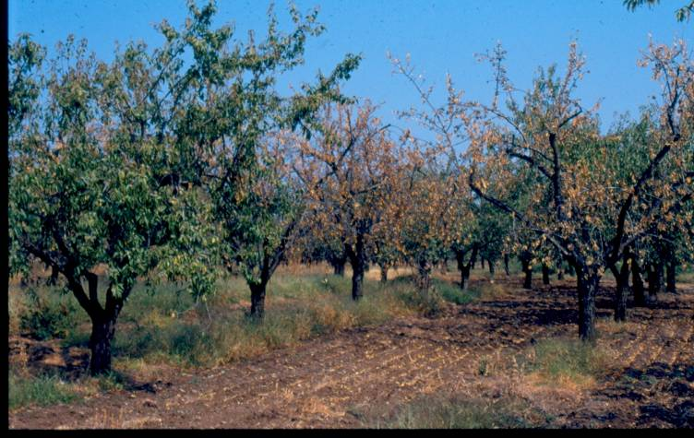
1. Phytiatry doctors are needed for diagnosis of plant diseases and pests to fulfill the requirements of modern, accurate and timely identification
Almond Orchard
Verticillium, Armillaria, Rosellinia, Capnodis teenebrionis or Phytophthora sp.

Slide 32
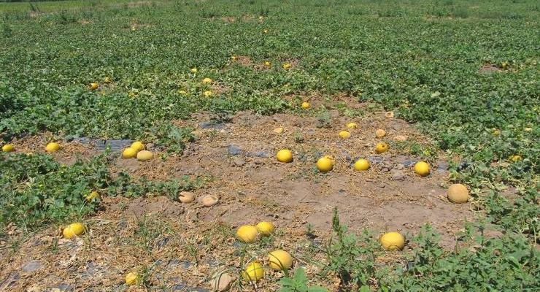
Recognition of cases with similar, thus confusing and missleading symptomatology
2. Phytiatry doctors to overcome problems related to similarities in symptom expression and distinguish the complicated field and orchard cases of plant disease and pest recognition.
Melon Field
Fusarium oxysporum f. sp. melonis, Monosporascus cannonballus, Olpidium bornovanus, or Verticillium dahliae ?

Slide 33
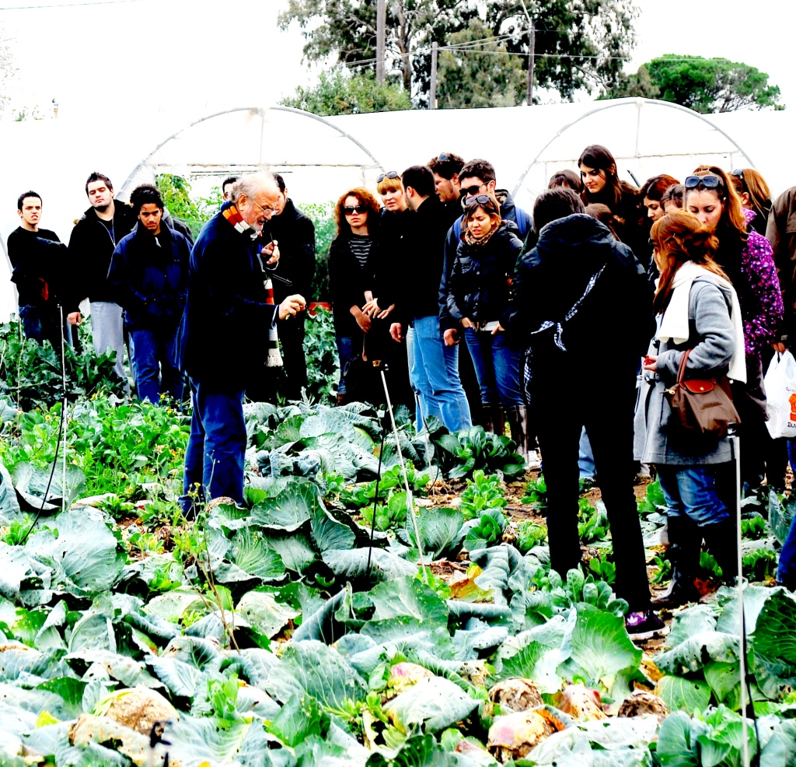
3. Phytiatry doctors able to diagnose plant and pest diseases and provide recommendations for their management

Slide 34
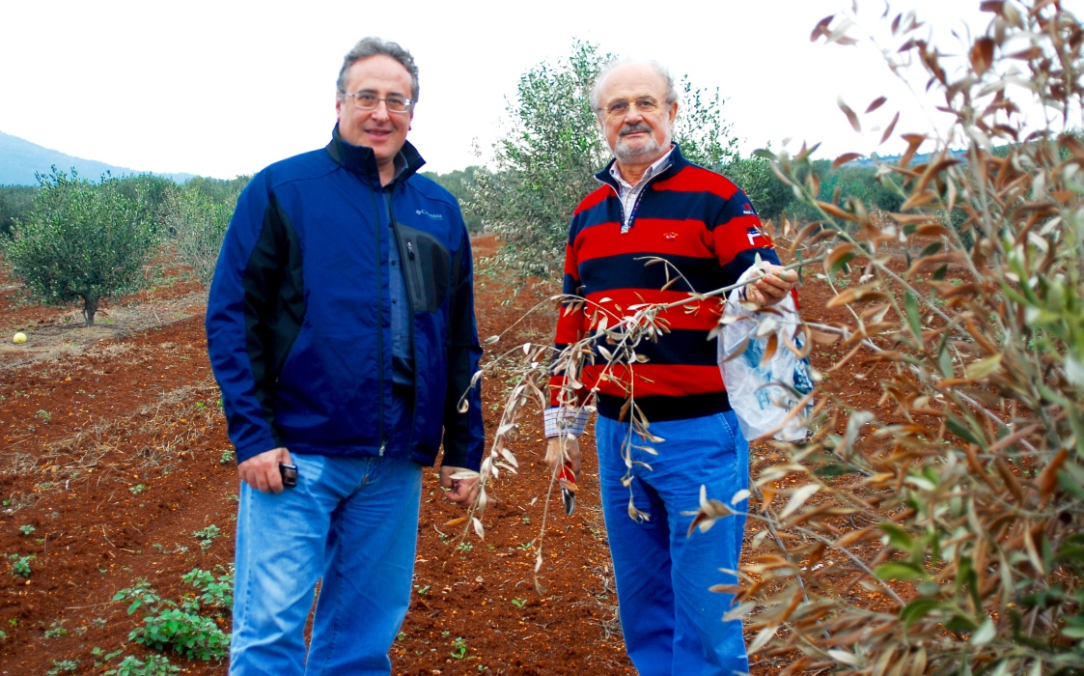
4. Phytiatry doctors to be in vigilance for quarantine pests and pathogens so to prevent their entrance and dispersal in regions, countries or continents, and spot outbreaks or re-emerging plant diseases and pests

Slide 35




Examples of International threats
1. Karnal (Partial) Bunt
Tilletia indica
2. Ug99 the emerging virulent stem rust race of
Puccinia graminis f.sp. tritici

Slide 36
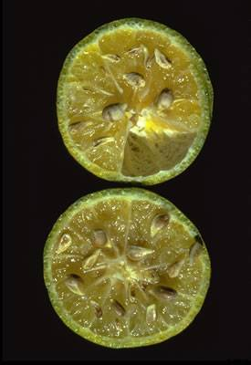
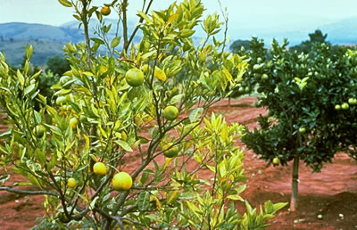
Citrus greening
Liberibacter asiaticus / Asian citrus psyllid

Slide 37

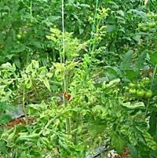
Candidatus Liberibacter psyllaurous
A bacterial species been found in association with serious diseases of tomatoes, potatoes

Slide 38
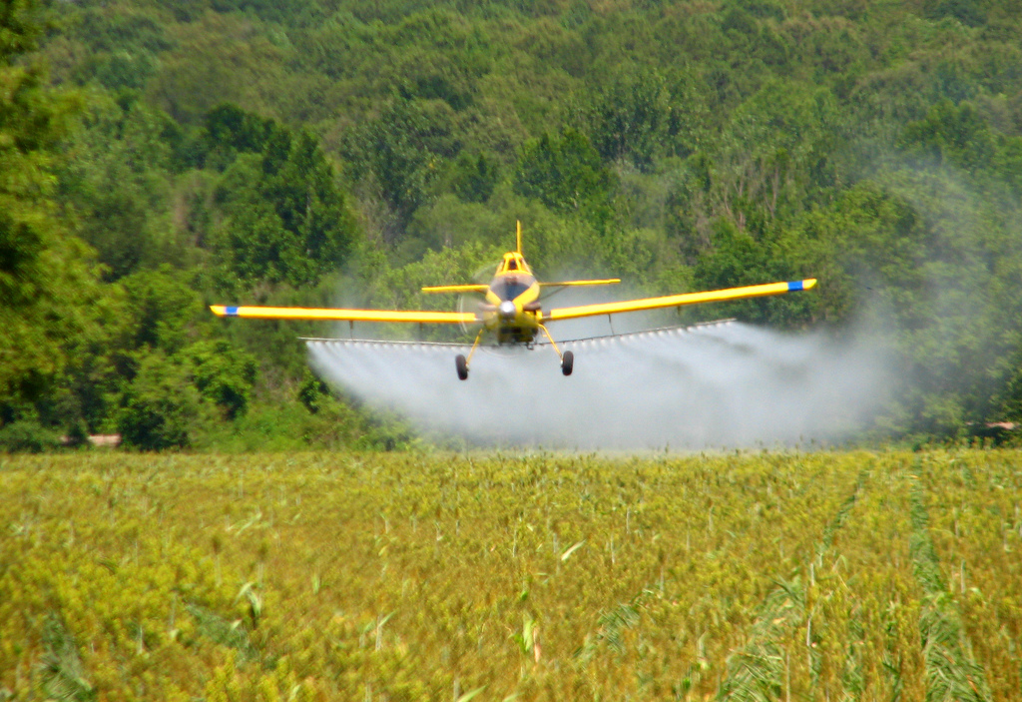
5. Phytiatry doctors to suggest suitable pest management, to introduce disease and pest forecasting/risk assessment models, to contribute to best pesticide selection and application for securing effectiveness and food safety

Slide 39
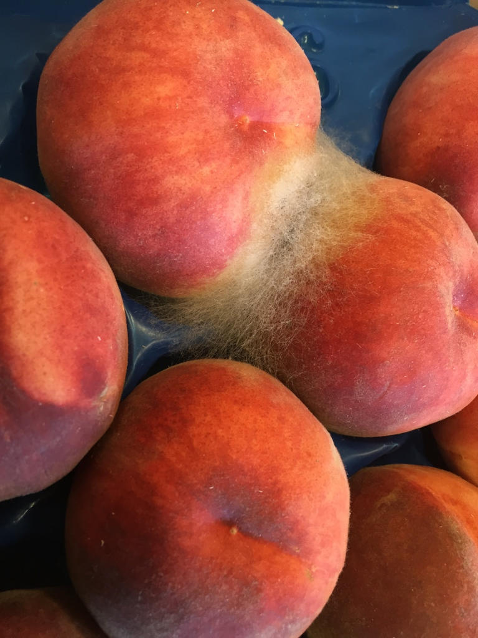
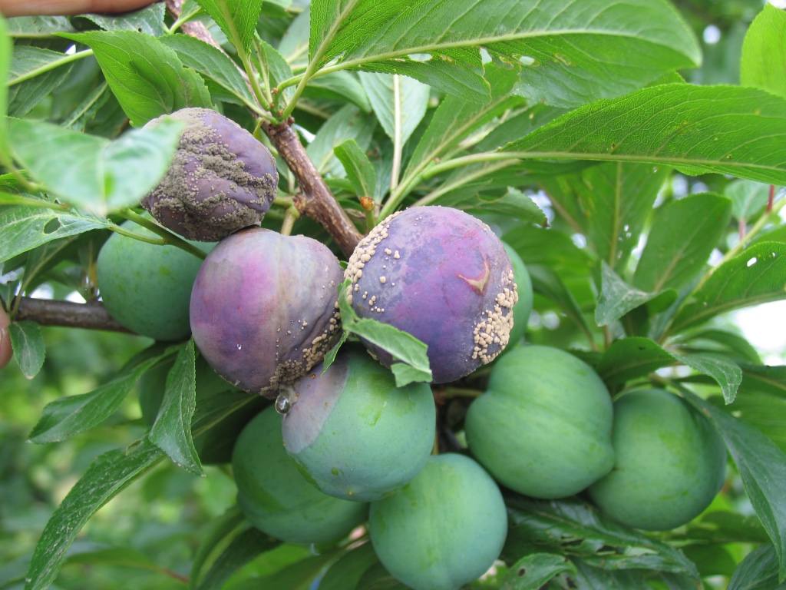
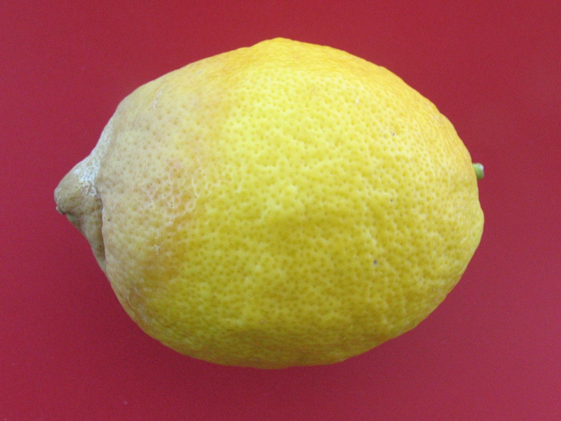
6. Phytiatry doctors to deal with complicated and so costly problems of postharvest phytiatry so common in modern agriculture

Slide 40
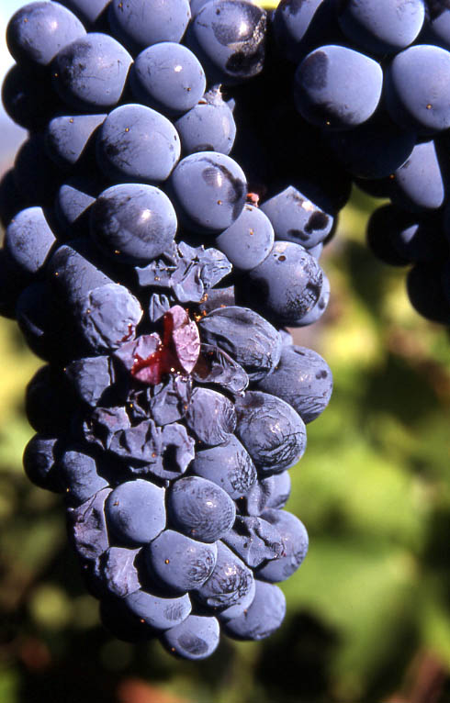
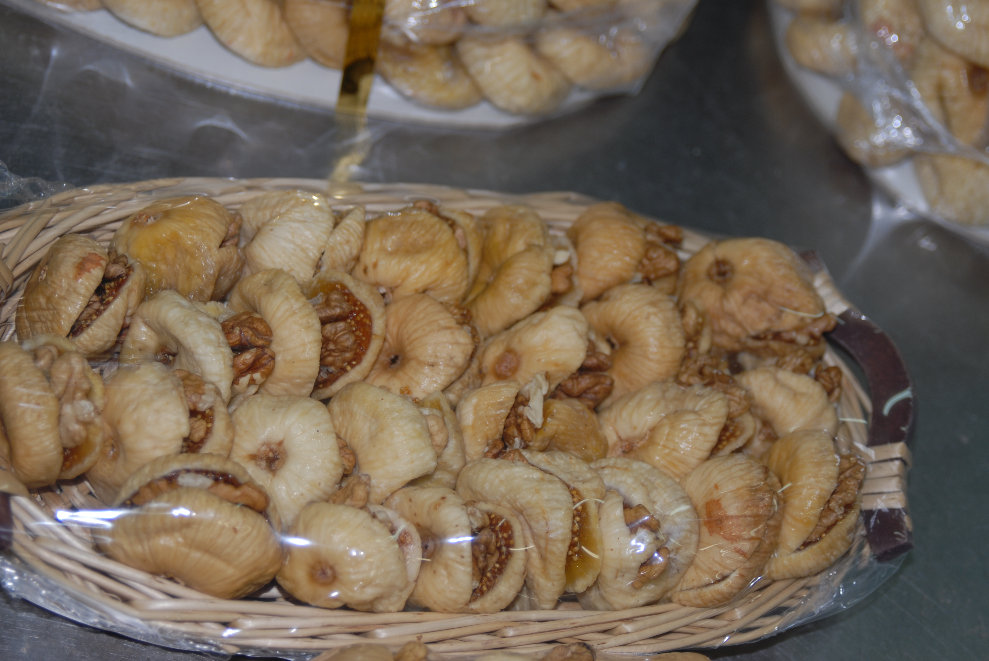
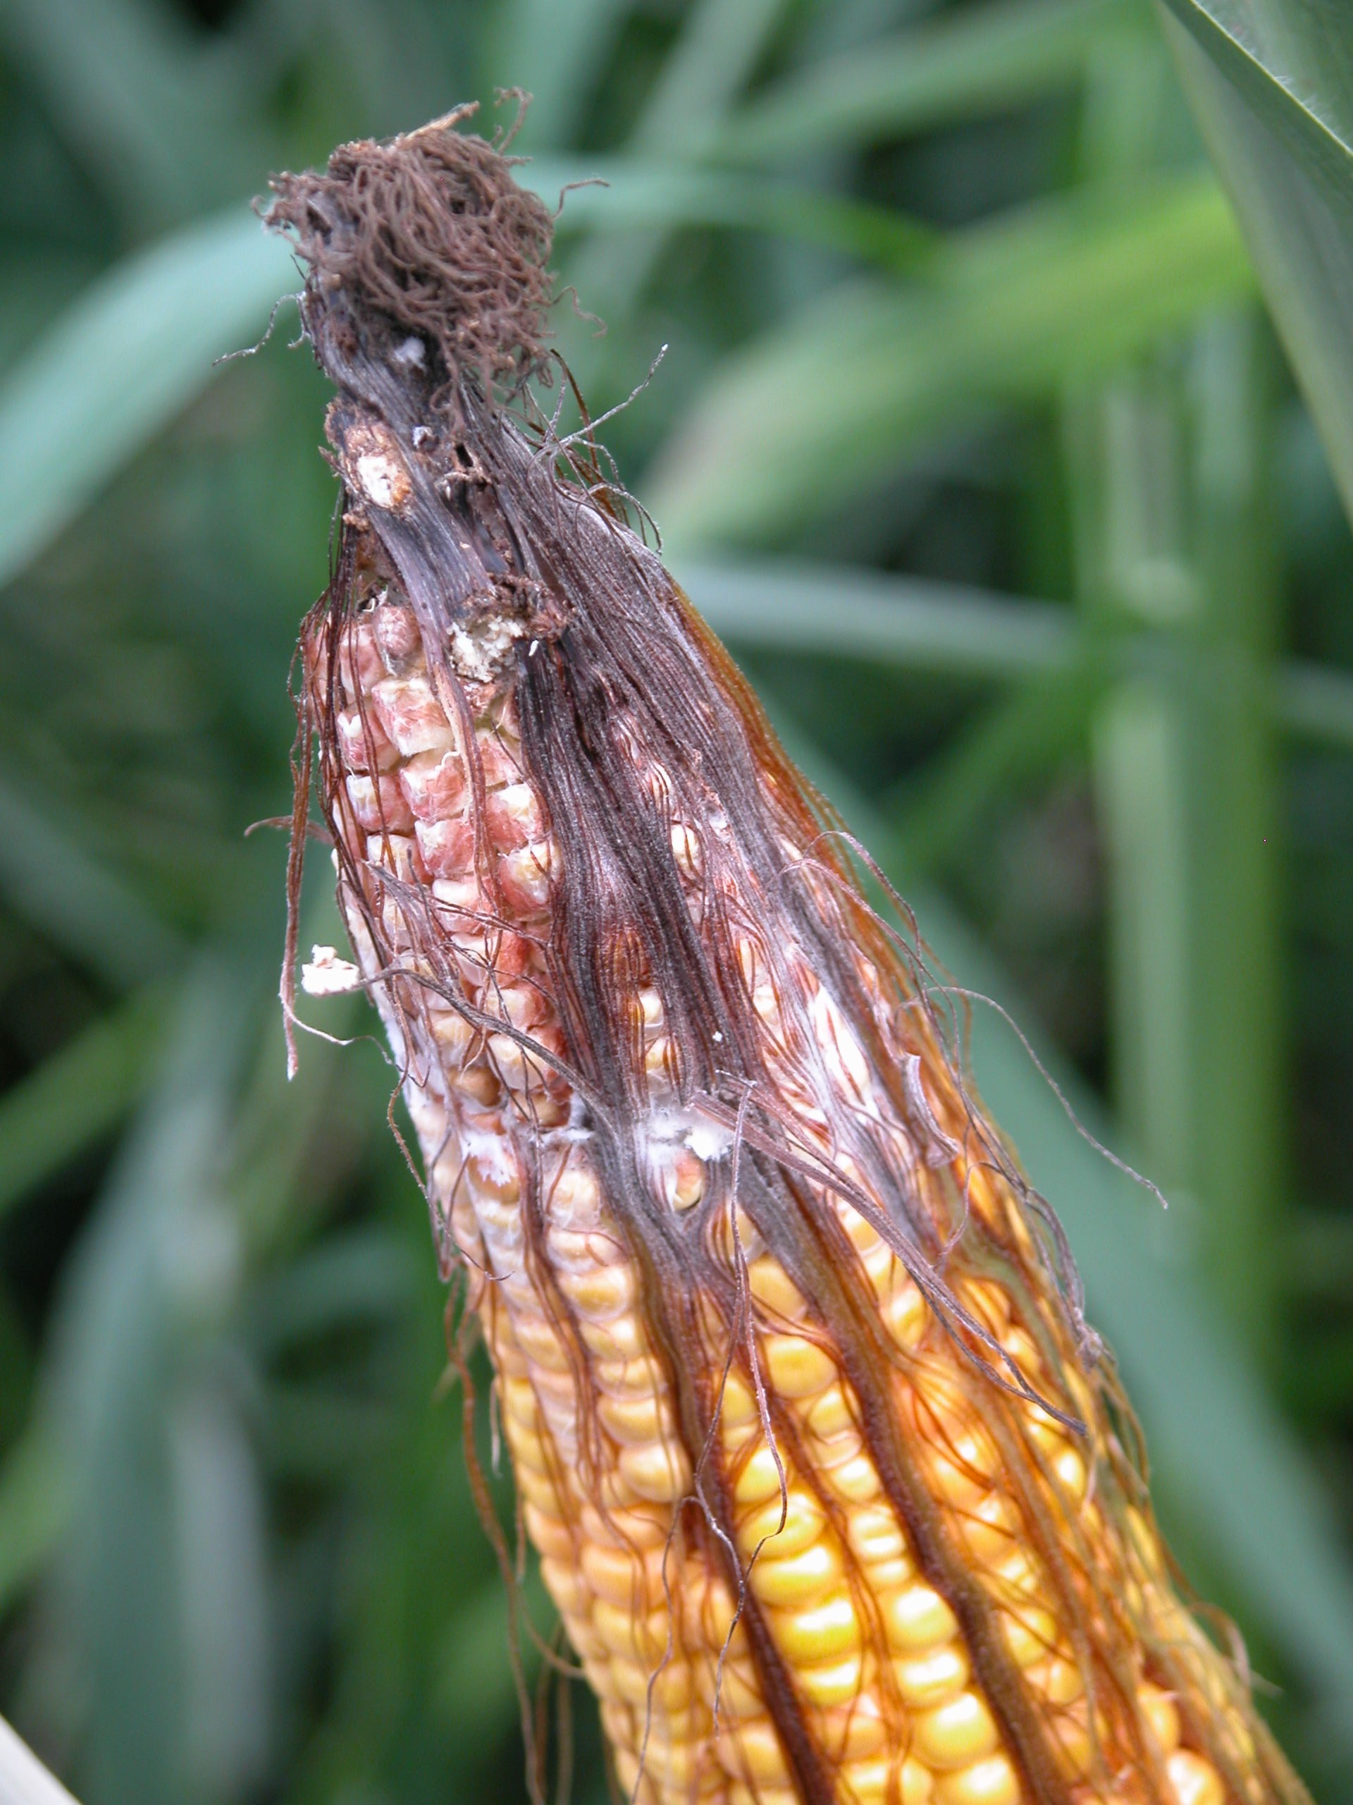
7. Phytiatry doctors to deal with the impact of mycotoxins on food safety, food quality and world trade and suggest measures for management of mycotoxigenic fungi.

Slide 41
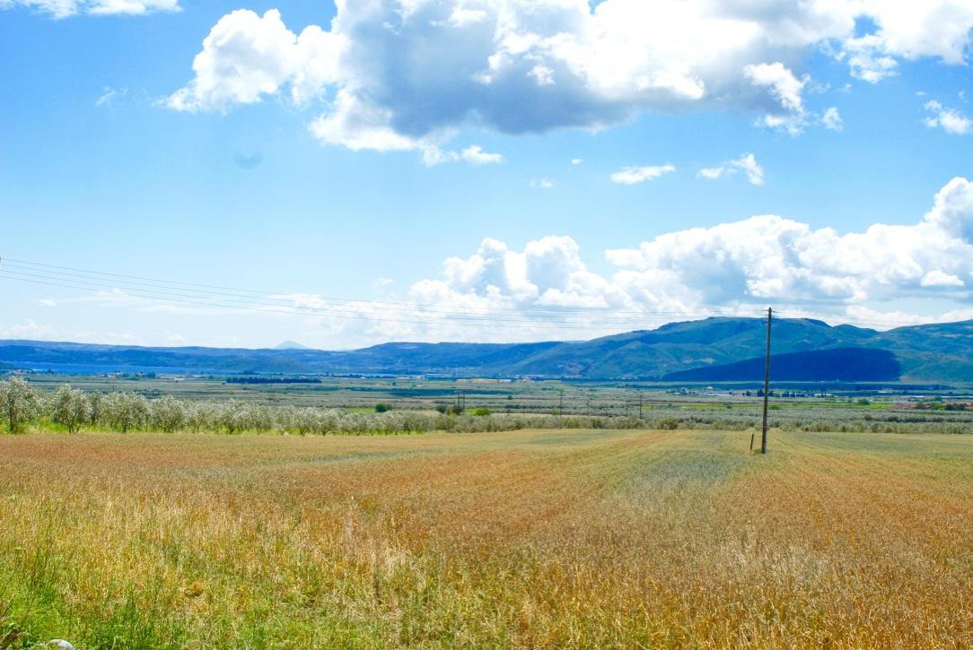
8. Phytiatry doctors to consult farmers how to select and effective apply biopesticides or biofertilizers

Slide 42
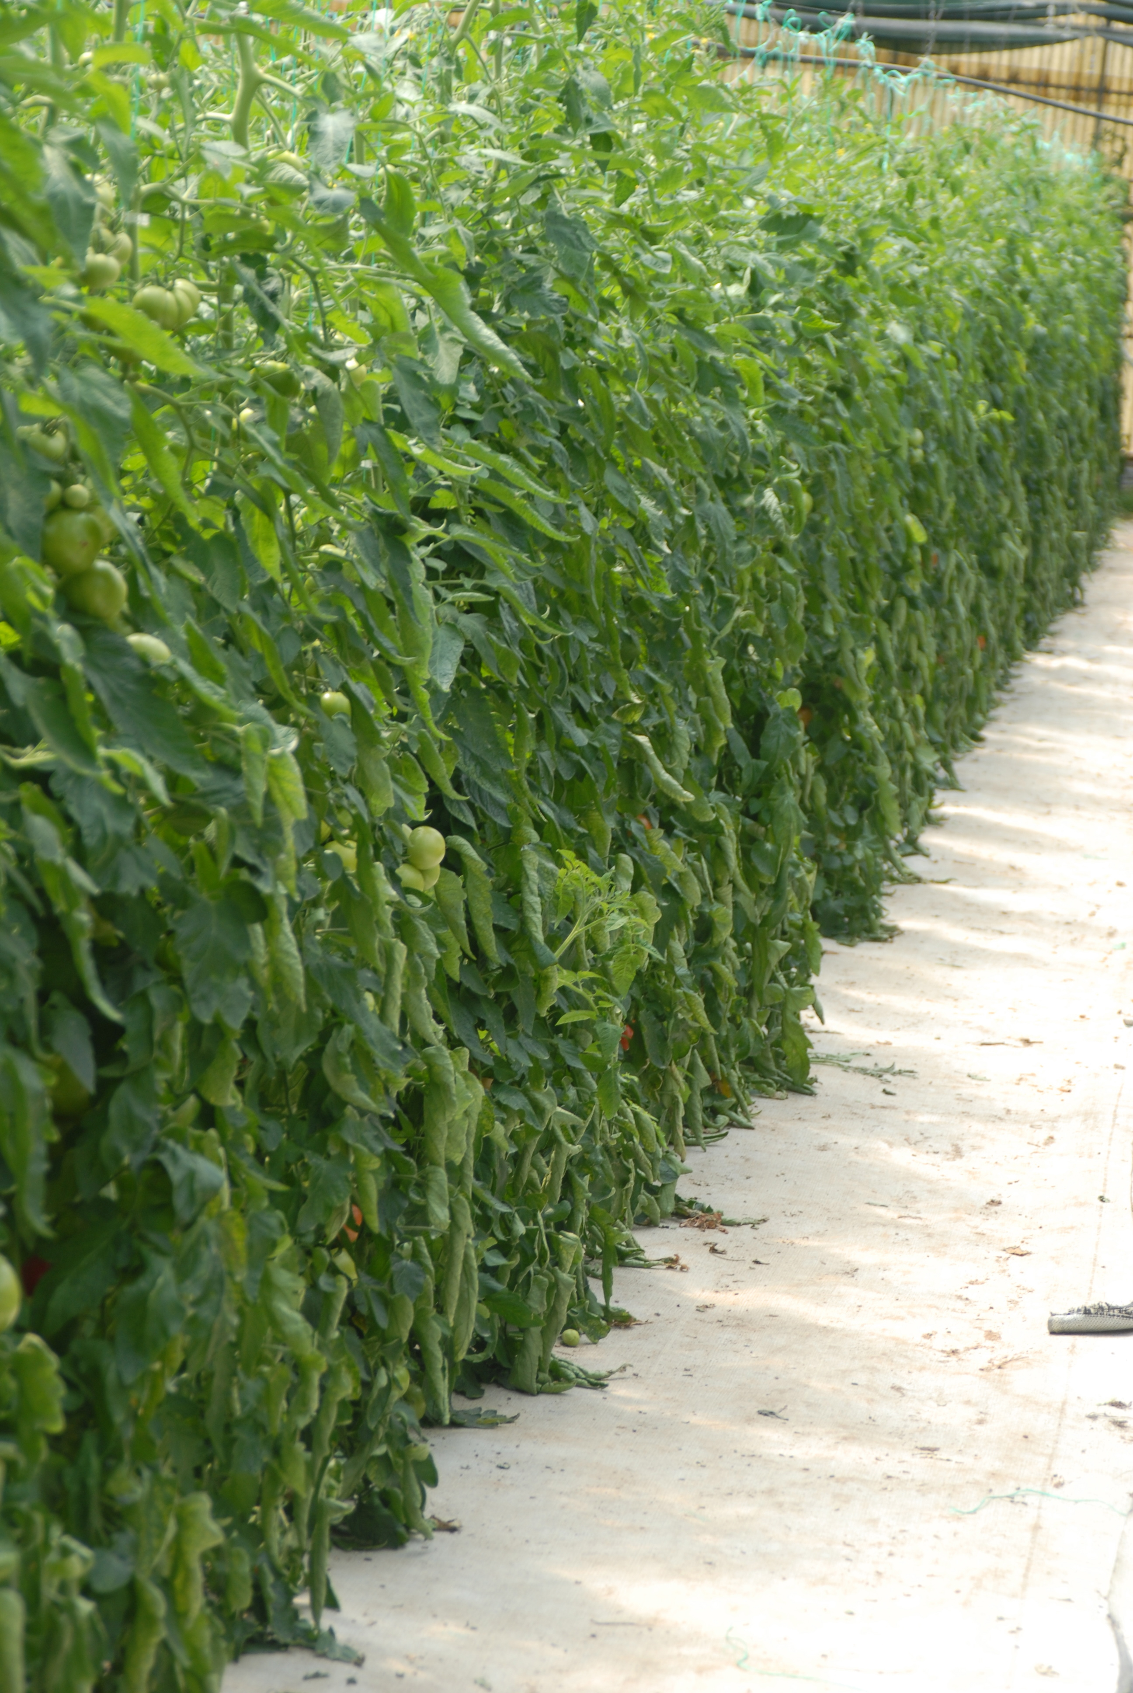
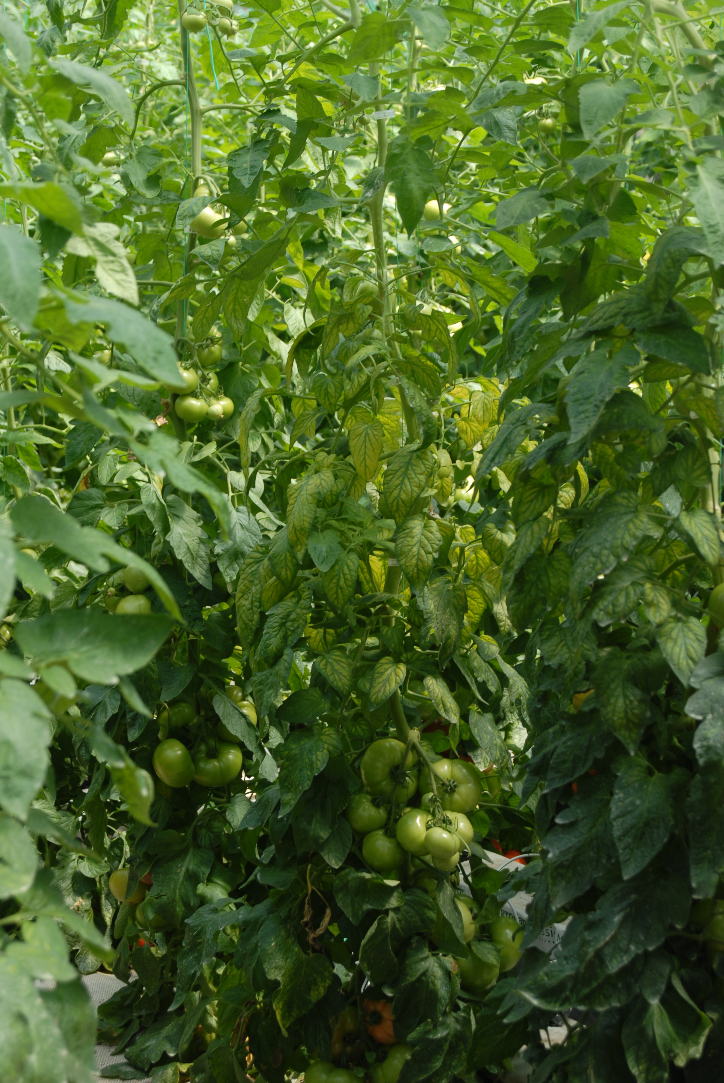
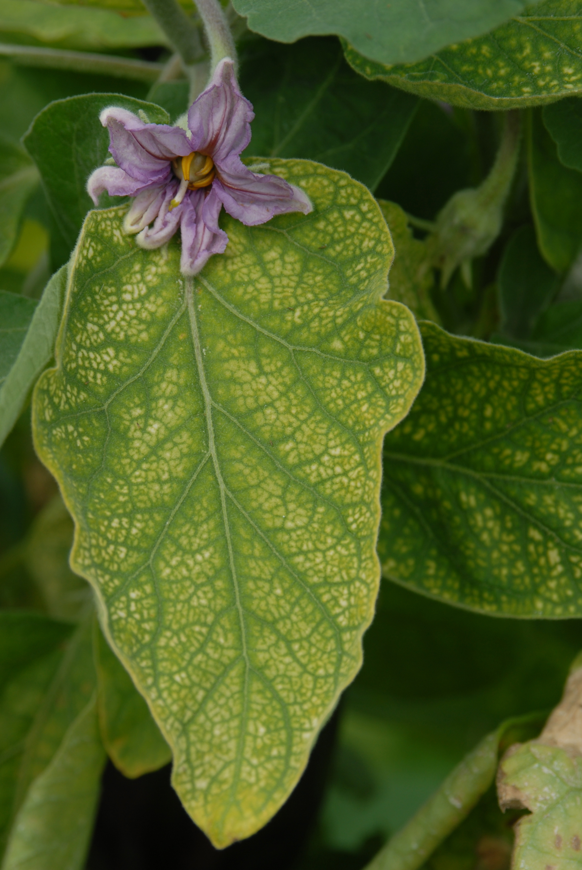
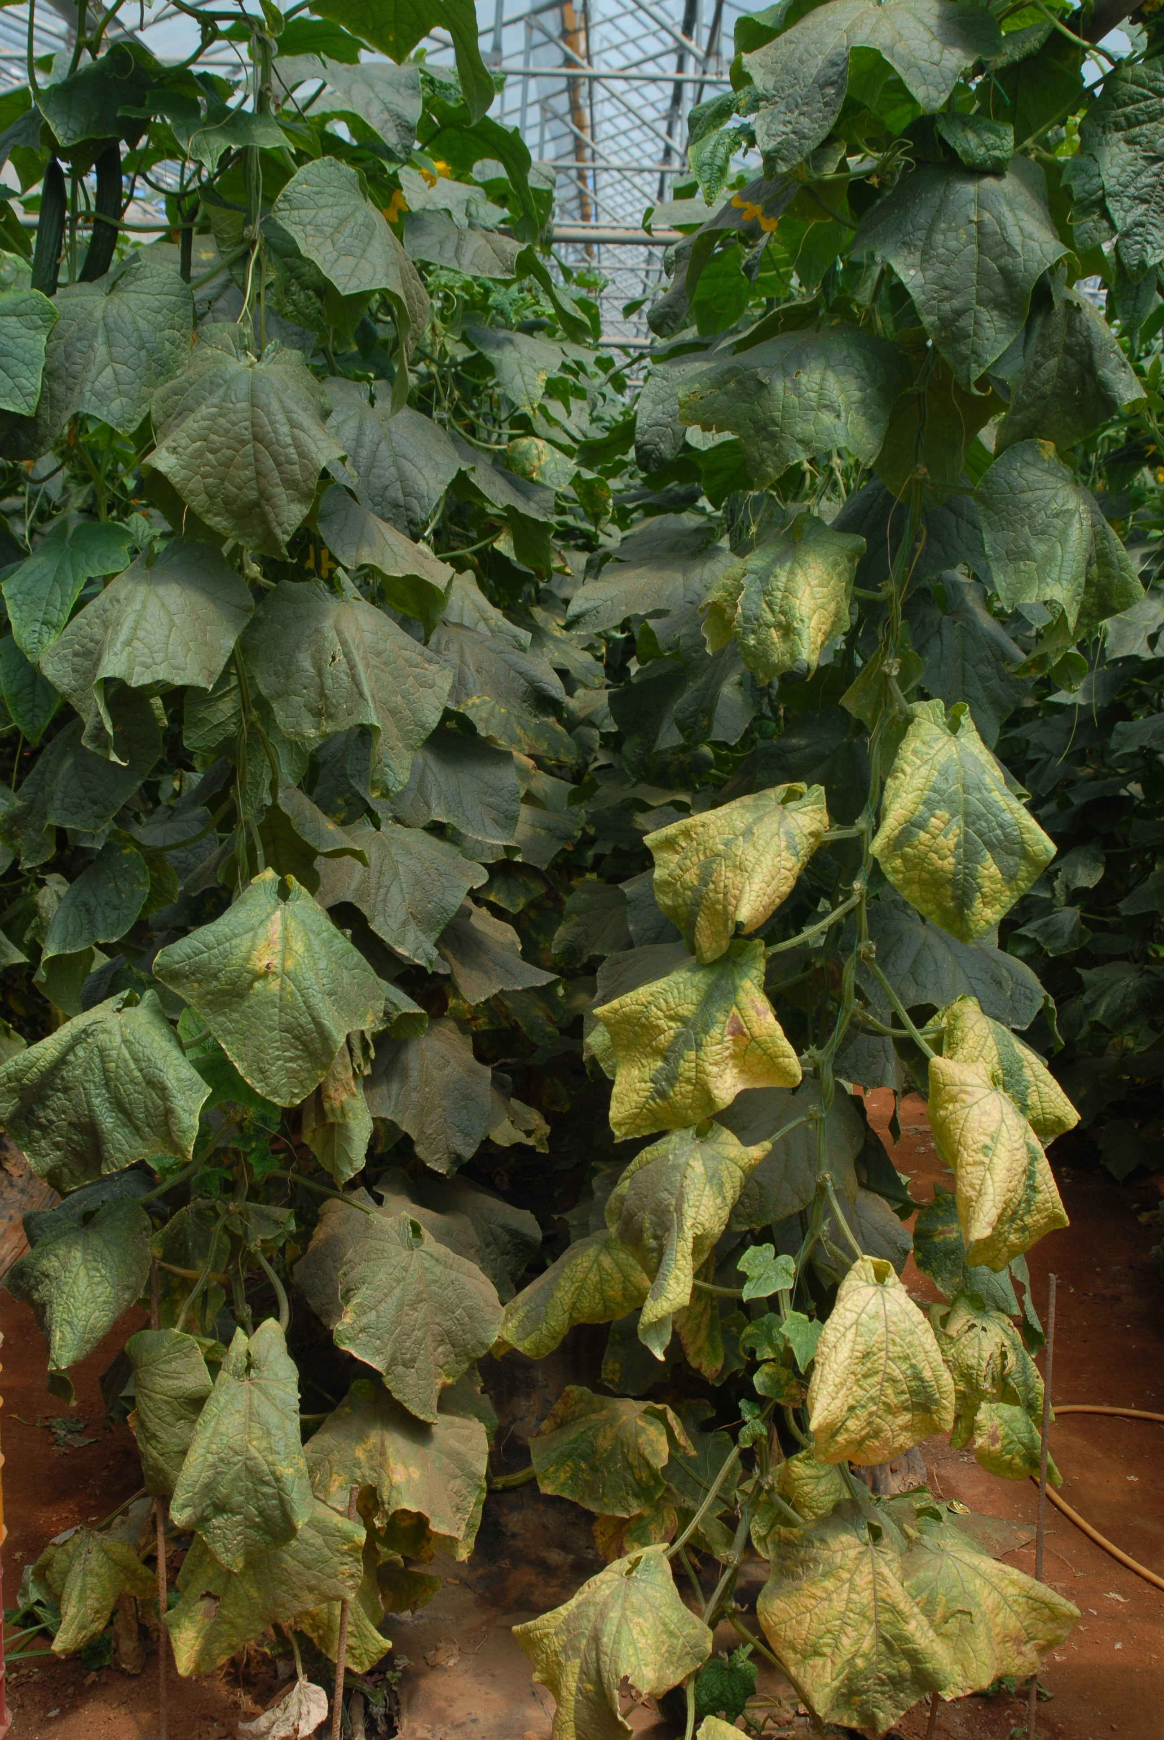
9. Phytiatry doctors able to provide appropriate and update plant nutrition instructions, to secure best plant growth related to crop health.

Slide 43
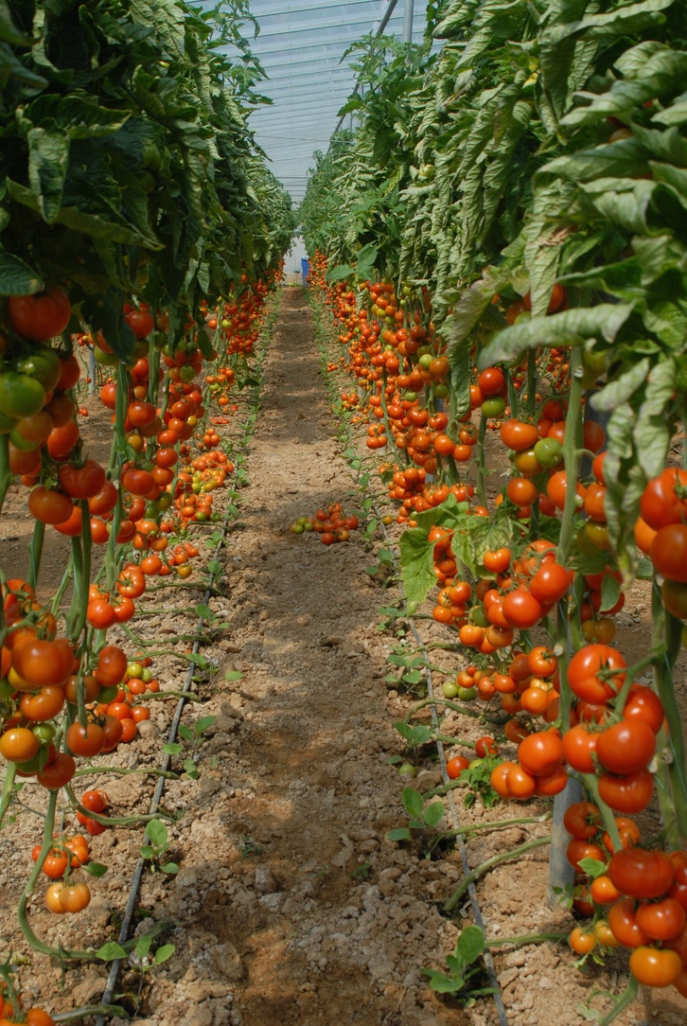
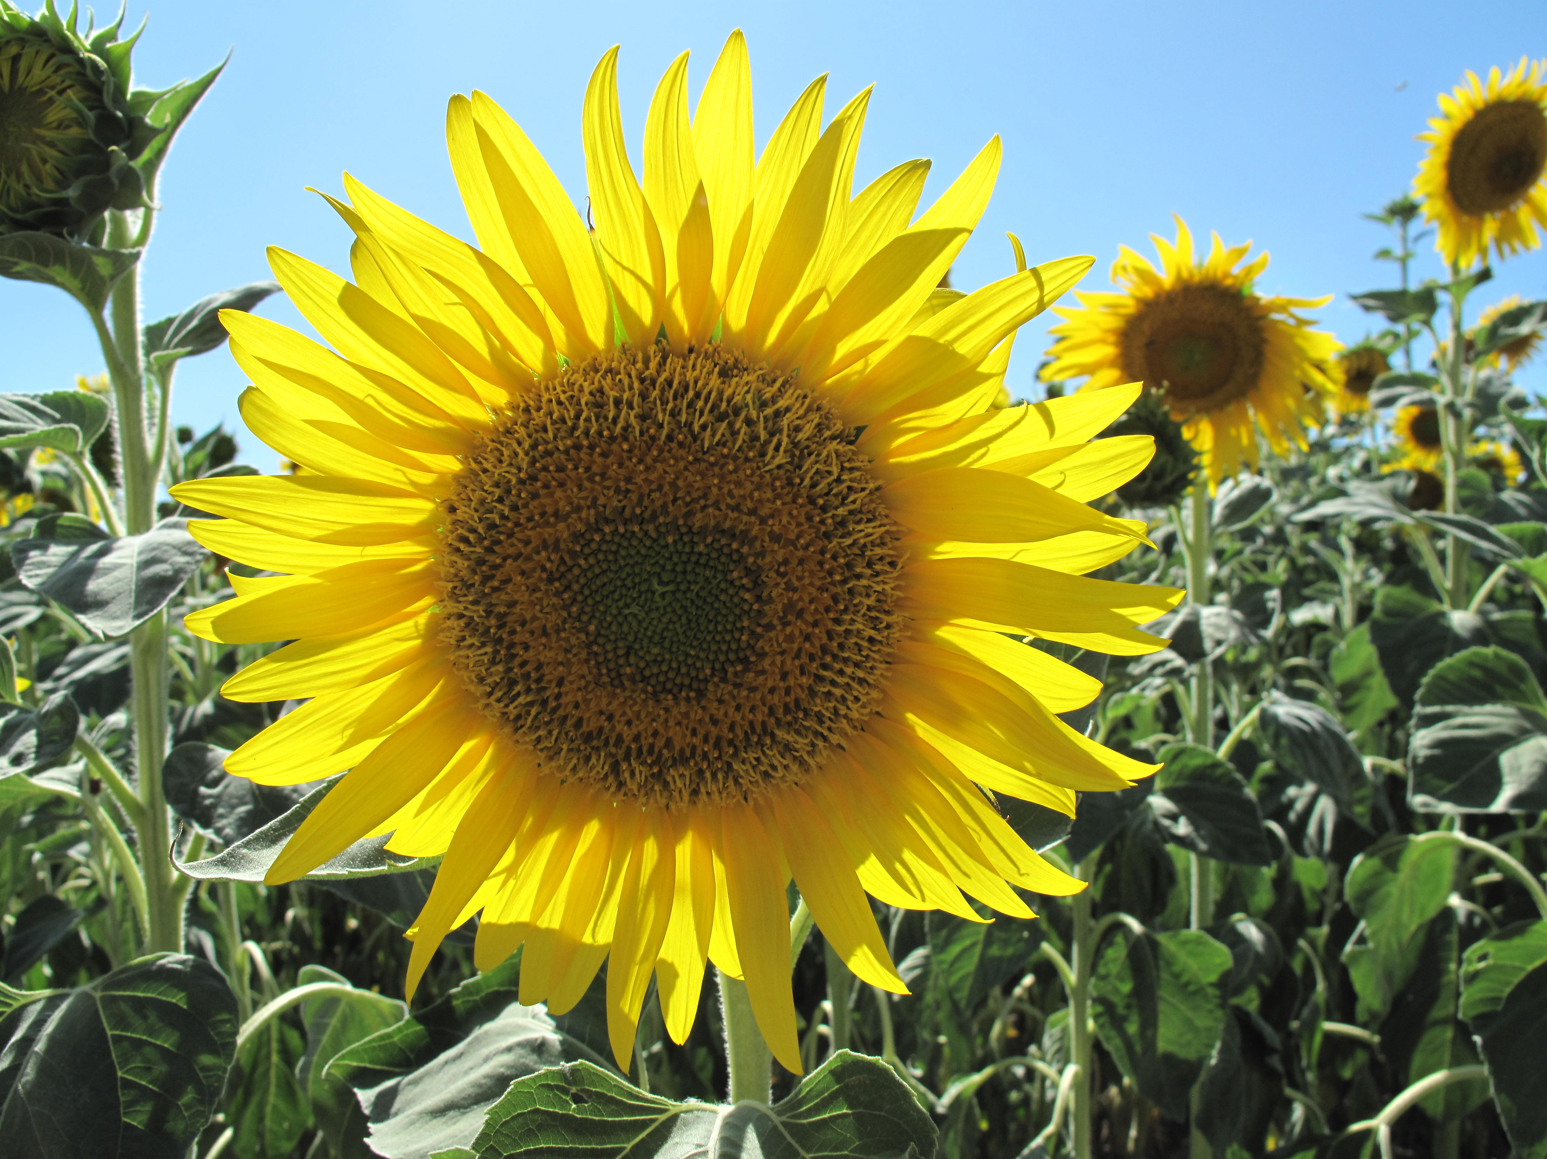
10. Phytiatry doctors to guide the farmers in producing quality products both for human consumption and animal feed

Slide 44
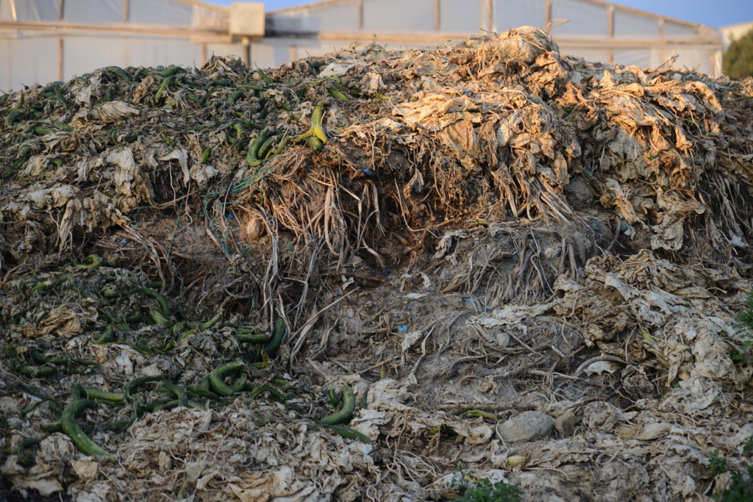
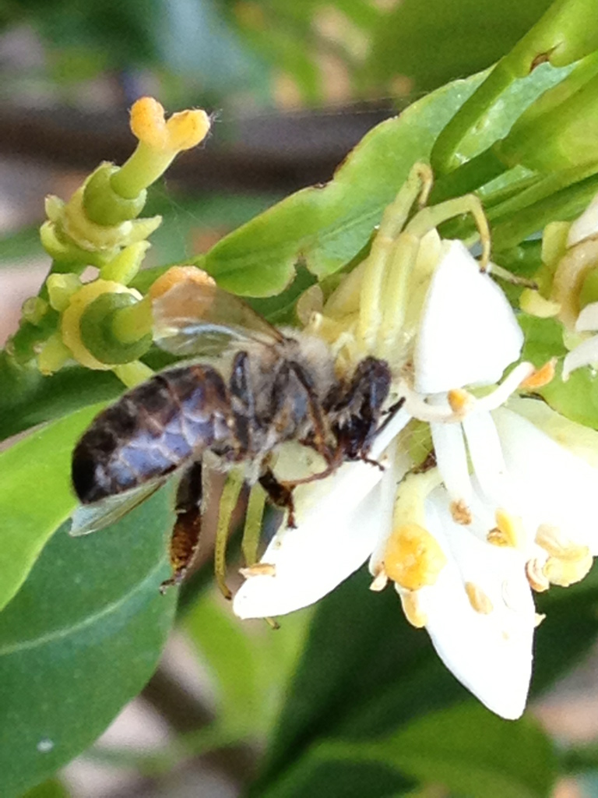
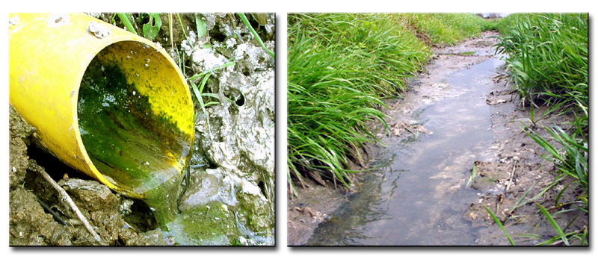
11. Phytiatry doctors to contribute in protecting agricultural environment and instruct farmers to take care of their farms, the agricultural environment and their personal health

Slide 45
12. Phytiatry doctors to deal with the forthcoming problems of climate change as related to plant diseases and pests
Climate Change and Phytiatry - Knowledge and Gaps
Andreas Fischlin
ETH Zurich - Coordinating Lead Author chapter «Ecosystems» of Assessment Report Four of the IPCC

Slide 46
13. Phytiatry doctors to deal with the organic farming problems related to the biological management of plant diseases and pests

Slide 47
14. Phytiatry doctors to contribute in reducing unjustifiable expenses or high costs in crop production, through accurate diagnosis, best selection of measures, appropriate timing in application and so on…

Slide 48
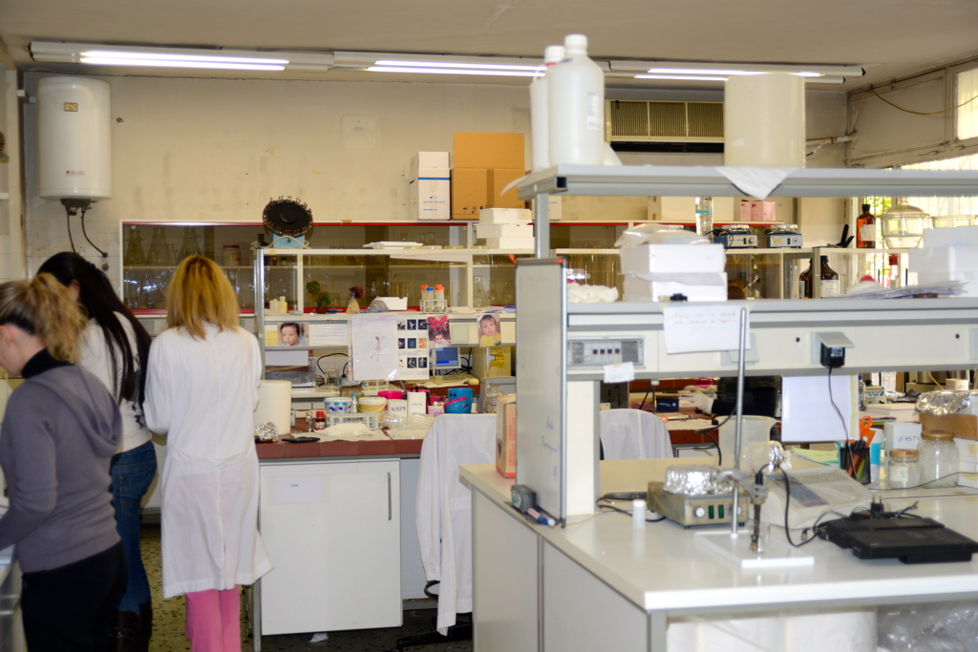
THE PROFESSION
Professional diagnosticians with a distinct 5 years course Phytiatry degree
1. Phytiatry doctors able to work as research specialists for Research Institutes after obtaining a M.SC. or even Ph.D.

Slide 49
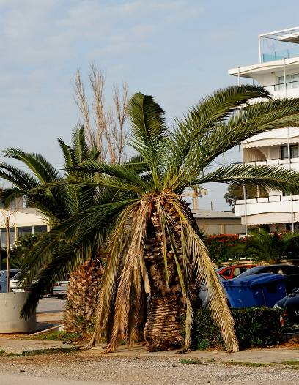
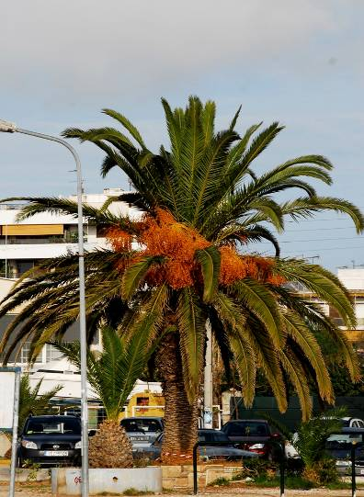
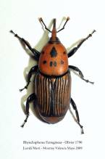
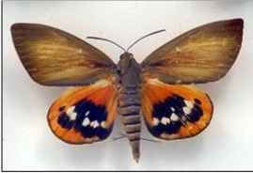
2. Phytiatry doctors, leaders in plant clinics on common or even rare or incoming diseases and pests in their region
Rhynchophorus ferrugineus or the current palm pest menace Paysandisia archon

Slide 50
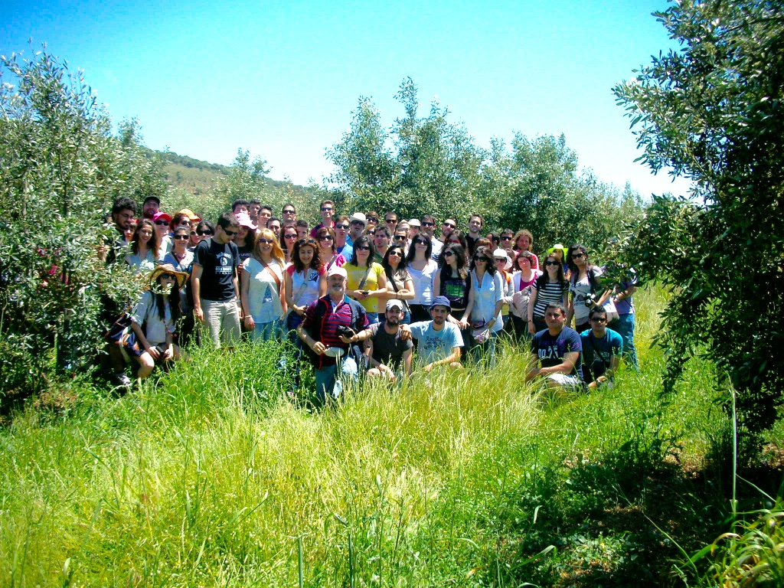
3. Phytiatry doctors to work as diagnosticians in first aid plant clinics or field and orchard inspections

Slide 51
4. Phytiatry doctors to work for plant diseases and pest problems in
gardening and landscape architecture

Slide 52
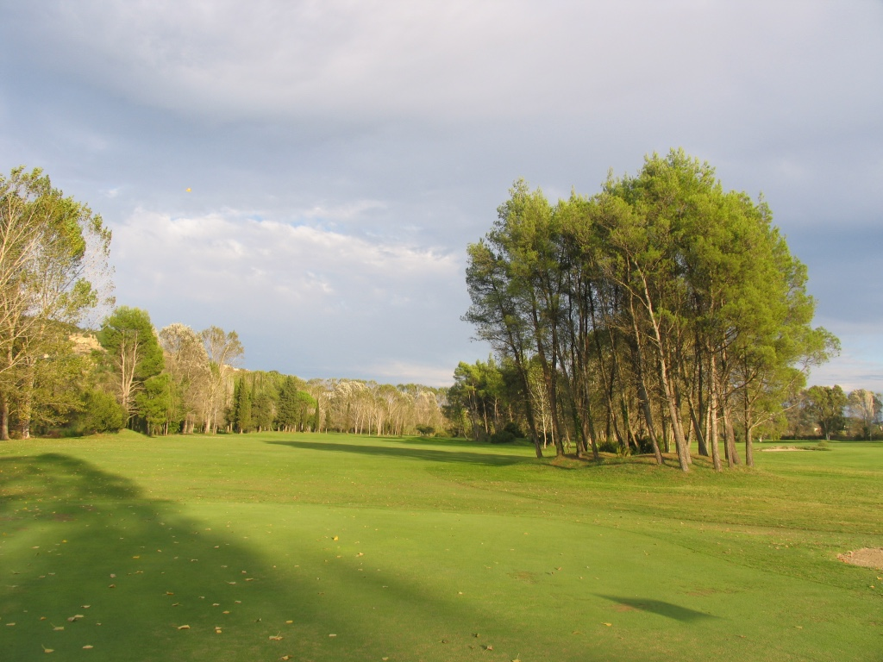
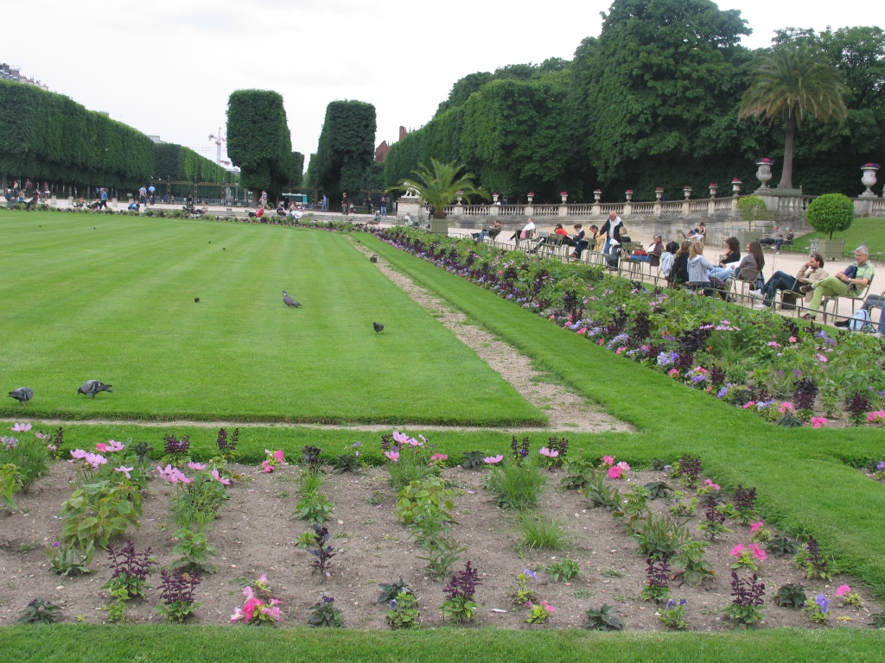
5. Phytiatry doctors to work for large municipalities and advice on management of diseases and pests affecting turf, flower beds, shrubs and trees in city parks, and along streets.

Slide 53
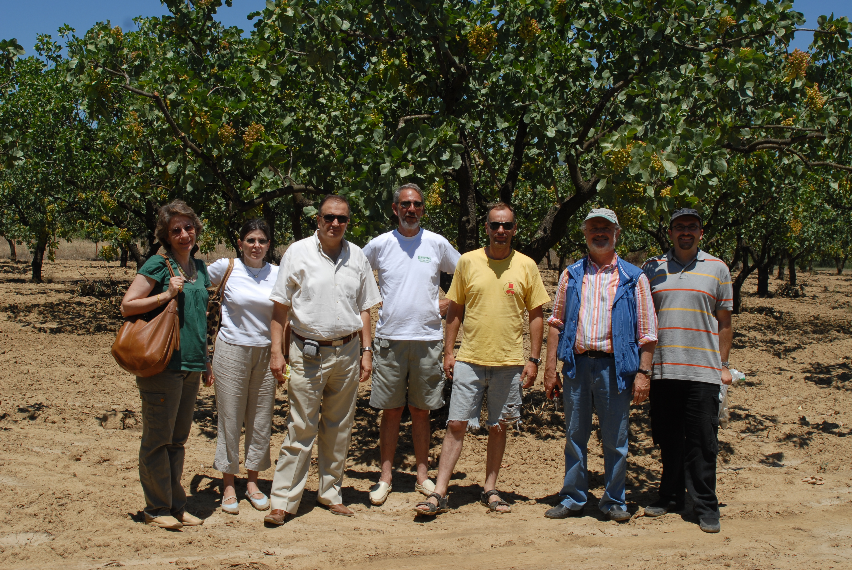
6. Phytiatry doctors to have employment opportunities for many different, challenging and well-paying jobs

Slide 54
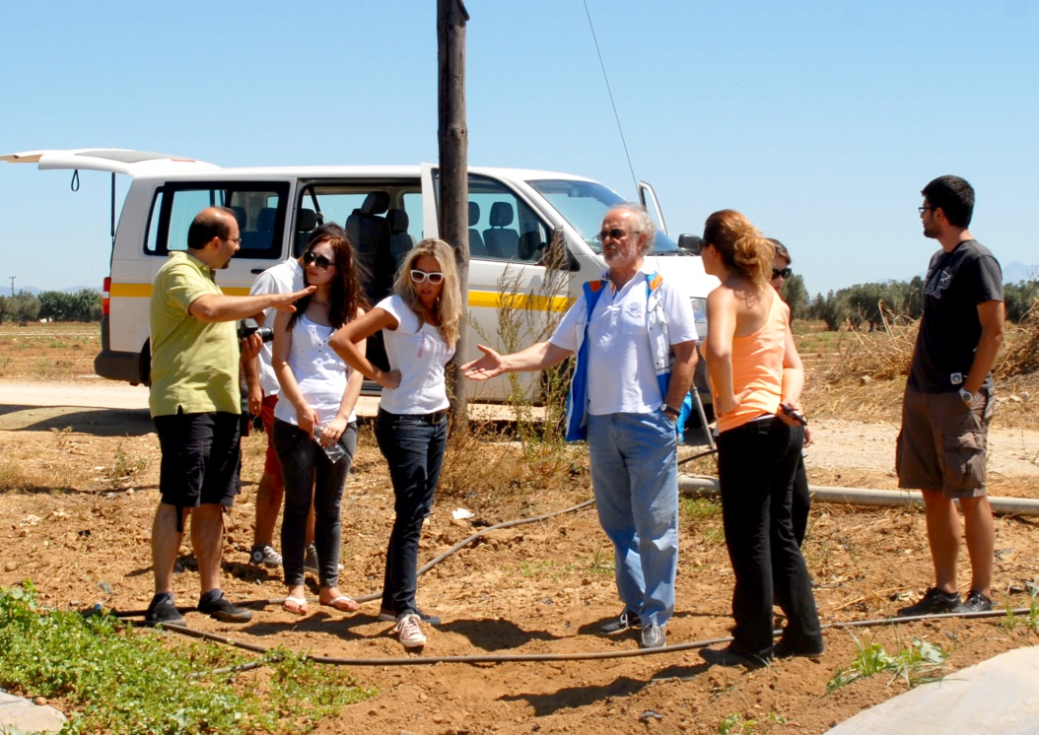
7. Phytiatry doctors to work as representatives of pharmaceutical industries or consultants of various biopesticide companies

Slide 55
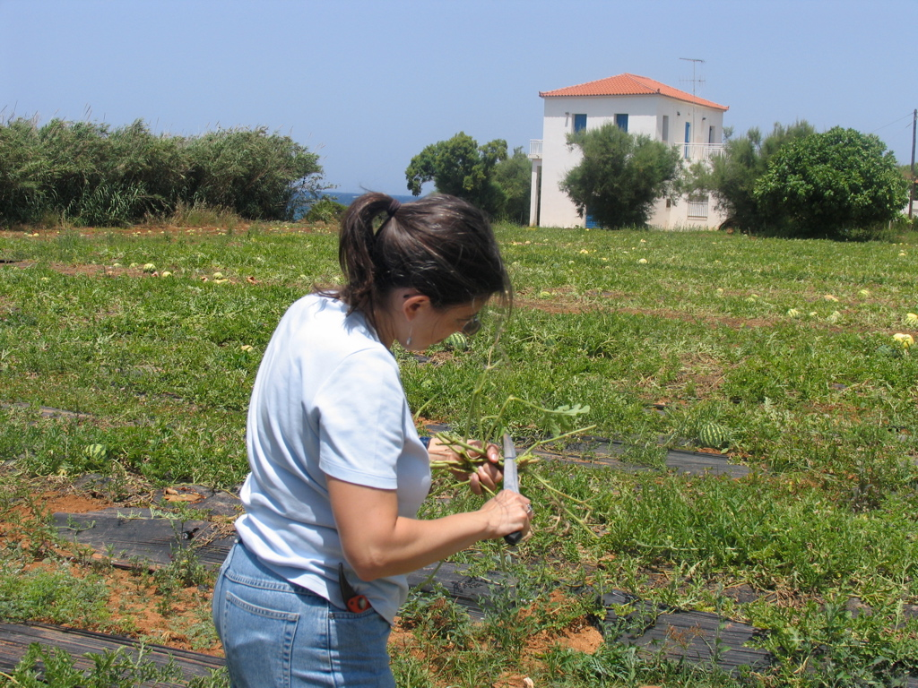
8. Phytiatry doctors to work as Plant pest consultants or inspectors working as practitioners for private sector or local governments

Slide 56
9. Phytiatry doctors to work as small business owners

Slide 57
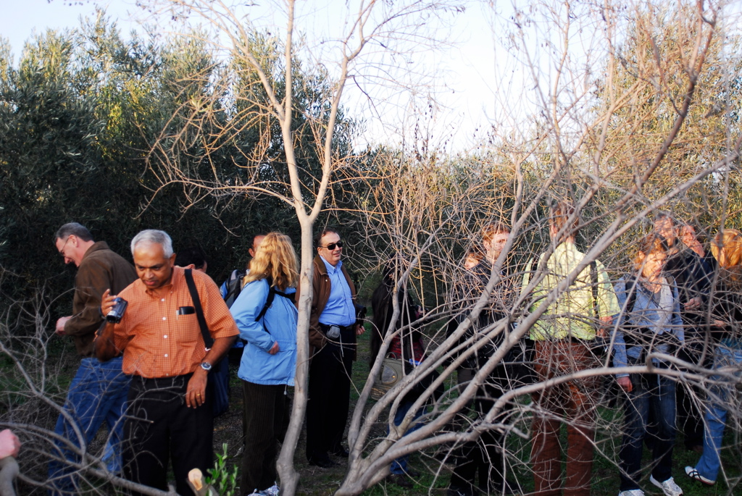
10. Phytiatry doctors even to work as crop consultants in developing countries in a way similar to the DOCTORS WITHOUT BORDERS efficiently and effectively

Slide 58
I am confident that the academicians will gradually support introduction of Phytiatry (Plant medicine) at an undergraduate level, as a vindication of the early efforts of the famous pioneers.
Among others by introducing the Phytiatry as a distinct University science we will avoid the so called plant doctors, who perpetuate sciolism with so destructive consequences for world agriculture.
Now…
I prefer the term Phytiatry instead of Plant Medicine in order to avoid the confusion which has been created by physicians or plain people thinking Plant Medicine as Human Medicine with plants.
The term Phytiatry could be the most appropriate name already used in French, Italian, English and Greek languages and coincides with the term phytomedicine in German.

Slide 59
ACTIONS
Time has already come for international common action by Academia, Universities, along with related Scientific Societies, the Private sector and Farmer unions to promote introduction of Phytiatry in Universities for Food security and Food quality and modernization of world agriculture.
What must be our next movement?

Slide 60
international activation and motivation
I think we must seek a massive international scientific support from relative disciplines, who share the same thoughts, towards changing the current situation and convince Academia to introduce Phytiatry in Universities world wide.
How
I propose among others

Slide 61
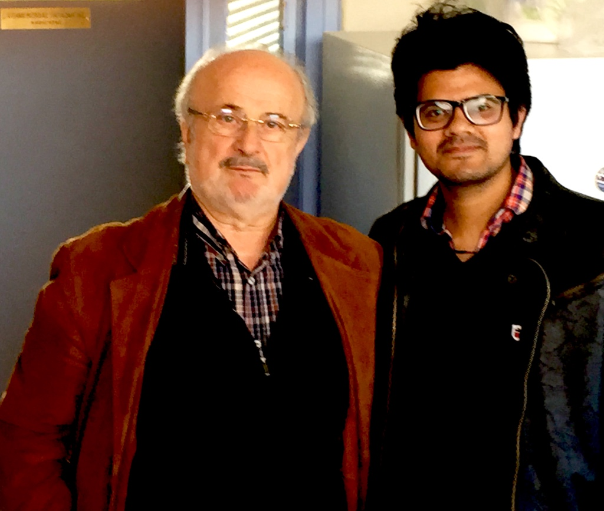
Electronic vote -Support phytiatry
We have already uploaded a pdf of this presentation on the web site of the Hellenic Society of Phytiatry for internet electronic voting to support introduction of Phytiatry in Universities world-wide.
Please visit the site www.fytiatriki.gr
A Student from India in our Plant Pathology department was the first to sign

Slide 62
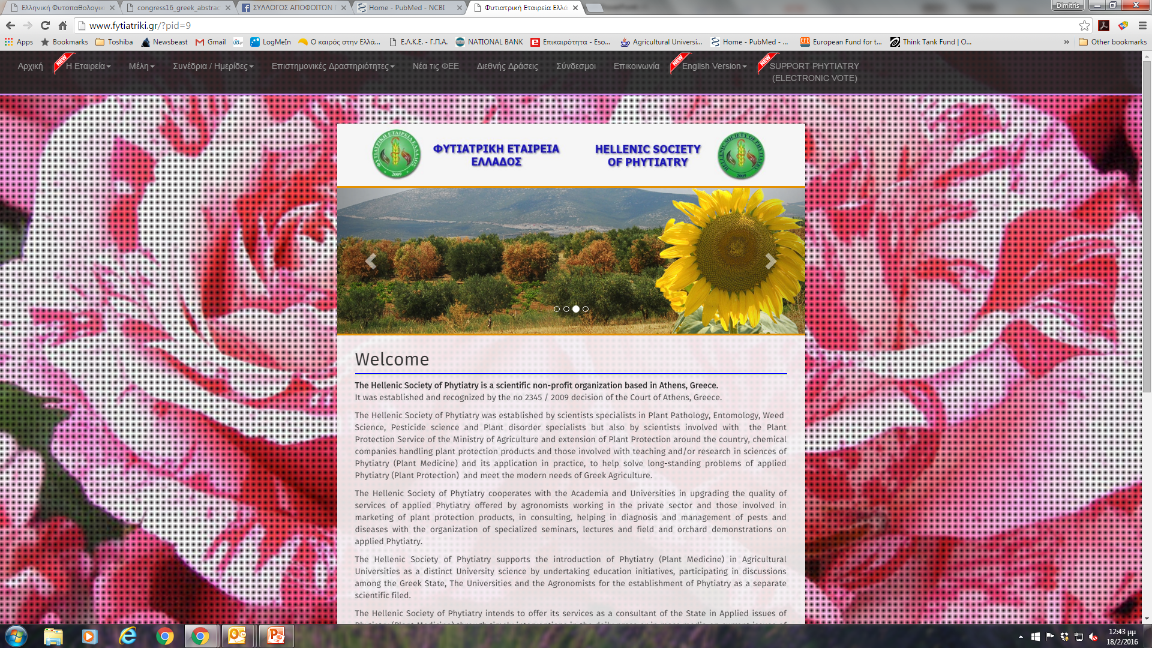
HELLENIC SOCIETY OF PHYTIATRY www.fytiatriki.gr

Slide 63

HELLENIC SOCIETY OF PHYTIATRY www.fytiatriki.gr
Electronic vote /Support phytiatry

Slide 64
Dear colleagues
I have a dream to succeed bearing in mind the words of the GREAT MAHATMA GANDHI
FIRST THEY IGNORE YOU, THEN THEY RIDICULE YOU,
THEN THEY FIGHT YOU, AND THEN YOU WIN.

Slide 65

THANK YOU SO MUCH FOR YOUR ATTENTION

